Slide 1


Python – Conditional Statements
Decision Making
M M Mahbubul syeed, phd. Associate professor

Slide 2
Highlight
Decision Making
Conditional Statement
Types of Conditional Statements
Examples..

Slide 3
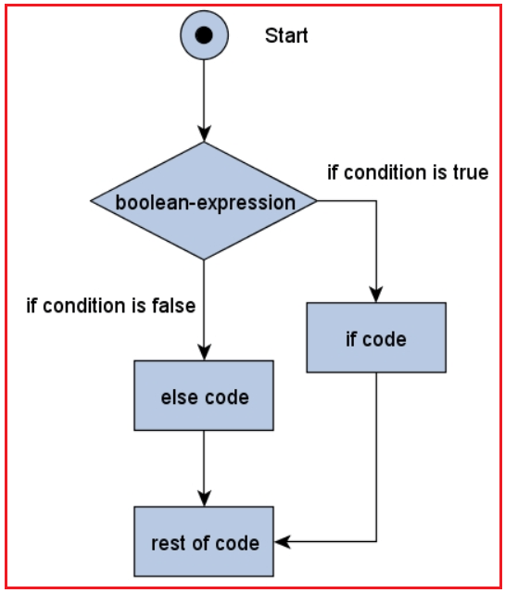
Decision Making
In
Programming

Slide 4
Decision Making
Decision-making is the anticipation of conditions occurring during the execution of a program and specified actions taken according to the conditions.
Decision structures evaluate multiple expressions.
Expression evaluates to TRUE or FALSE as the outcome.
Based on the result (TRUE or FALSE) appropriate actions are taken.

Slide 5
Decision Making – Buy a mobile!!
Visit the shop
If (brand == ‘samsung’ & price <= 80000)
Will visit mobile shop to buy one.
Decision is based on the brand and budget.
Choice of brand is Samsung and the price must be within 80k. Otherwise, will buy the phone later.
If condition
is True
If condition
is False
Buy
Phone
Buy
Later
Get back
Home

Slide 6
Decision Making – > Conditional Statement
Visit the shop
If (brand == ‘samsung’ & price <= 80000)
Conditional statements are the means of decision making in Programming.
If condition
is True
If condition
is False
Python programming language assumes
any non-zero and non-null values as TRUE
any zero or null values as FALSE value.
Buy
Phone
Buy
Later
Get back
Home

Slide 7
Decision Making – > Conditional Statement
Real life scenario!
If it rains tomorrow, I'll clean up the basement. After that I will paint the walls. If there is any time left, I will file my tax return. Otherwise, i.e., if it will not rain, I will go swimming. In the evening, I will go to the movies!

Slide 8
Decision Making – > Conditional Statement
Real life scenario!
If it rains tomorrow, I'll clean up the basement. After that I will paint the walls. If there is any time left, I will file my tax return. Otherwise, i.e., if it will not rain, I will go swimming. In the evening, I will go to the movies.
Breaking it down according to condition -
If it rains tomorrow, I will do the following:
- Clean up the basement
- Paint the walls
If there is any time left:
I will make my tax declaration
Otherwise, I will do the following:
Go swimming
Finally, Going to the movies in the evening.

Slide 9
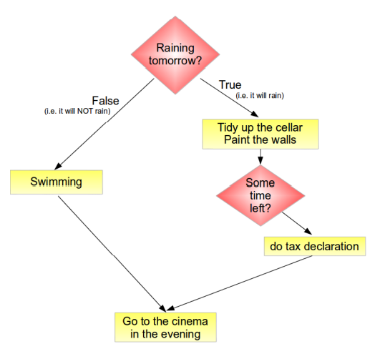
Decision Making – > Conditional Statement
Breaking it down according to condition -
If it rains tomorrow, I will do the following:
- Clean up the basement
- Paint the walls
If there is any time left:
I will make my tax declaration
Otherwise, I will do the following:
- Go swimming
Finally, Going to the movies in the evening.
True
False

Slide 10
Decision Making – > Conditional Statement
Python programming language provides the following types of decision-making statements.
Conditional Statement | Description
if statement | An if statement consists of a Boolean expression followed by one or more statements.
if...else statements | An if statement can be followed by an optional else statement, which executes when the boolean expression is FALSE.
Nested if statements | You can use one if or else if statement inside another if or else if statement(s).

Slide 11
Decision Making
In
Programming
If
Statement

Slide 12
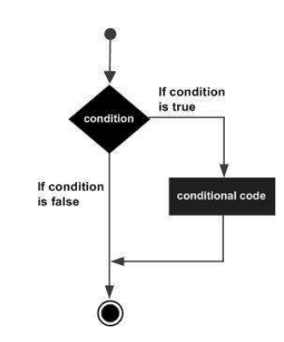
if statement
The if statement contains a logical expression (Condition) using which the data is compared and a decision is made based on the result of the comparison.
Syntax:
if expression:
statement(s)

Slide 13
if statement
Syntax:
if expression:
statement(s)
If the expression evaluates to TRUE then
the block of statement(s) inside the if statement is
executed.
If the expression evaluates to FALSE then
the first set of code after the end of block is executed.

Slide 14
if statement - Example
You would like to go to the university. It’s a rainy season. So, before going out .. You are checking whether it is raining or not. If it’s raining you will take an umbrella before leaving for the university.
Preparing for going out.
Checking the weather..
if (its raining):
Take umbrella
Leave for University.
Preparing for going out.
Checking the weather..
if (is_raining == True):
Take umbrella
Leave for University.
or

Slide 15
if statement - Example
Let's consider you are paying monthly salary to your employee. If your employee worked overtime, you would pay 5% extra on their usual salary. Otherwise, they will get their usual salary.
Salary = Get employee salary..
worked overtime = ‘yes’
if (worked overtime == ‘yes’):
Salary += Salary * .05
Print (Salary)

Slide 16
if statement – Example Code
You would like to go to the university. It’s a rainy season. So, before going out .. You are checking whether it is raining or not. If it’s raining you will take an umbrella before leaving for the university.
decision = 'no umbrella'
print('Will leave for the university..')
weather_condition = input('Is it raining?: ')
if(weather_condition == 'yes' or weather_condition == ‘true’):
decision = 'umbrella'
print(f'Going to university with {decision}')

Slide 17
if statement – Example Code
Let's consider you are paying monthly salary to your employee. If your employee worked overtime, you would pay 5% extra on their usual salary. Otherwise, they will get their usual salary.
salary = int(input('Get employee salary: '))
has_overtime = input('Has overtime: ')
if (has_overtime == 'yes'):
salary += salary * .05
print(f'Final salary is: {salary}')

Slide 18
Decision Making
In
Programming
If - else
Statement

Slide 19
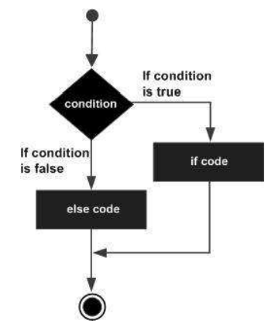
If - else statement
An else statement is combined with an if statement.
If the condition in If block evaluates False
Only then else block is executed.

Slide 20
If - else statement
An else statement is combined with an if statement.
If the condition in If block expression evaluates False
Only then else block is executed.
Syntax:
if expression:
statement(s)
else:
statement(s)

Slide 21
If - else statement
An else statement is combined with an if statement.
If the condition in If block expression evaluates False
Only then else block is executed.
Syntax:
if expression:
statement(s)
else:
statement(s)
True
False

Slide 22
If - else statement - Example
An else statement is combined with an if statement.
If the condition in If block expression evaluates False
Only then else block is executed.
Let's consider you have a fashion house. For Eid, you are providing discount to the customers based on the purchased amount. Your policy is as follows, if a customer purchase over 10k then she will get 15% discount otherwise, 7.5% discount.

Slide 23
If - else statement - Example
Let's consider you have a fashion house. For Eid, you are providing discount to the customers based on the purchased amount. Your policy is as follows, if a customer purchase over 10k then she will get 15% discount otherwise, 7.5% discount.
purchase_amount = Get customer purchase amount…
if (purchase_amount > 10000):
purchase_amount -= purchase_amount *.15
else:
purchase_amount -= purchase_amount *.075
print(purchase_amount)

Slide 24
If - else statement – Code Example
purchase_amount = int(input('Purchase amount: ‘))
if (purchase_amount > 10000):
print('Applicable discount is 15%')
purchase_amount -= purchase_amount *.15
else:
print('Applicable discount is 7.5%')
purchase_amount -= purchase_amount *.075
print(f'Customer has to pay after discount {purchase_amount} bdt')
Sample Output:
Purchase amount: 13000
Applicable discount is 15%
Customer has to pay after discount 11050.0 bdt

Slide 25
Decision Making
In
Programming
IF...ELIF...ELSE
Statement

Slide 26
IF...ELIF...ELSE - statement
If you have multiple (more than two) mutually exclusive conditions to check and decide, then you have to use,
IF...ELIF...ELSE
Syntax:
if expression1:
statement(s)
elif expression2:
statement(s)
elif expression3:
statement(s)
else:
statement(s)

Slide 27
IF...ELIF...ELSE - statement
False
if expression1:
statement(s)
elif expression2:
statement(s)
elif expression3:
statement(s)
else:
statement(s)
True
(1)
False
True
(2)
Flow of
Execution
False
True
(3)
(4)

Slide 28
IF...ELIF...ELSE - Example
If you have multiple (more than two) mutually exclusive conditions to check and decide, then you have to use,
IF...ELIF...ELSE
Let's consider you have a fashion house. For Eid, you are providing discount to the customers based on the purchase amount. Your policy is as follows,
if a customer purchase equal or over 50k then she will get 25% discount.
if a customer purchase between 40k and 50k then she will get 20% discount.
if a customer purchase between 25k and 40 k then she will get 10% discount.
Otherwise, there is no discount.

Slide 29
IF...ELIF...ELSE - Example
purchase_amount = Get the purchase amount
if purchase_amount >= 50000:
Discount is 25%
purchase_amount -= purchase_amount * .25
elif purchase_amount >= 40000 and purchase_amount < 50000:
Discount is 20%
purchase_amount -= purchase_amount * .2
elif purchase_amount >= 25000 and purchase_amount < 40000:
Discount is 10%
purchase_amount -= purchase_amount * .1
else:
No Discount
Finally, show the payable amount based on above discount calculation!
Your policy is as follows,
if a customer purchase equal or over 50k then she will get 25% discount.
if a customer purchase between 40k and 50k then she will get 20% discount.
if a customer purchase between 25k and 40k then she will get 10% discount.
Otherwise, there is no discount.

Slide 30
IF...ELIF...ELSE – Code Example
purchase_amount = int(input('Purchase amount: '))
if purchase_amount >= 50000:
print('Applicable discount is 25%')
purchase_amount -= purchase_amount * .25
elif purchase_amount >= 40000 and purchase_amount < 50000:
print('Applicable discount is 20%')
purchase_amount -= purchase_amount * .2
elif purchase_amount >= 25000 and purchase_amount < 40000:
print('Applicable discount is 20%')
purchase_amount -= purchase_amount * .1
else:
print('No discount is available for this purchase amount!')
print(f'Customer has to pay after discount {purchase_amount} bdt')
Your policy is as follows,
if a customer purchase equal or over 50k then she will get 25% discount.
if a customer purchase between 40k and 50k then she will get 20% discount.
if a customer purchase between 25k and 40k then she will get 10% discount.
Otherwise, there is no discount.

Slide 31
Decision Making
In
Programming
Nested IF
Statement

Slide 32
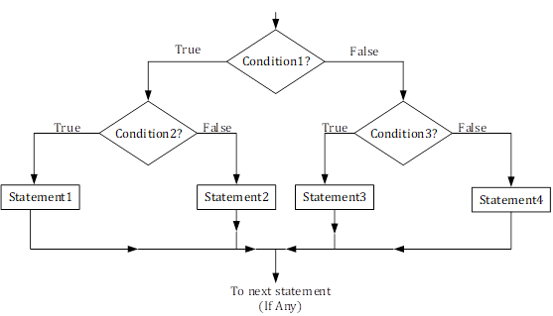
Nested if- Statement
Sometimes we have nested conditions! i.e, condition within a condition.
If one condition is True then we have to check another condition….
In such a situation,
we use the nested if construct.

Slide 33
Nested if- Statement
if expression1:
statement(s)
if expression2:
statement(s)
elif expression3:
statement(s)
else
statement(s)
elif expression4:
statement(s)
else:
statement(s)

Slide 34

Nested if- Statement Example
if expression1:
statement(s)
if expression2:
statement(s)
elif expression3:
statement(s)
else
statement(s)
elif expression4:
statement(s)
else:
statement(s)
You are given three numbers. Now, find the largest among these three numbers!
Brain storm here!

Slide 35
Nested if- Statement Code Example
You are given three numbers. Now, find the largest among these three numbers!
n1 = int(input('Number1: '))
n2 = int(input('Number2: '))
n3 = int(input('Number3: '))
if n1 > n2:
if n1 > n3:
print(f'Largest Number is {n1}')
else:
print(f'Largest Number is {n3}')
elif n2 > n3:
print(f'Largest number is {n2}')
else:
print(f'Largest number is {n3}')
if expression1:
statement(s)
if expression2:
statement(s)
elif expression3:
statement(s)
else
statement(s)
elif expression4:
statement(s)
else:
statement(s)

